Slide 1
CAP7001:
Data Communication and Networking
Unit-II
Transmission Media
(Unguided Media)

Slide 2
Unguided Media
Wireless without physical medium.
Air carries electromagnetic energy.
Categories: radio, microwave, infrared.
Antennas used for radiation.
Free-space propagation mechanisms apply.

Slide 3
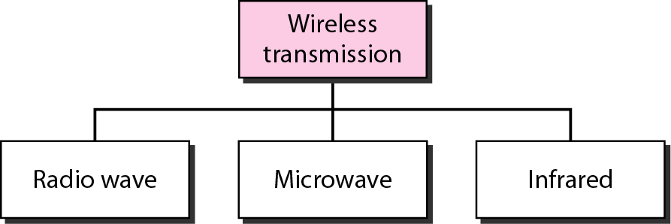
Wireless Transmission Waves

Slide 4
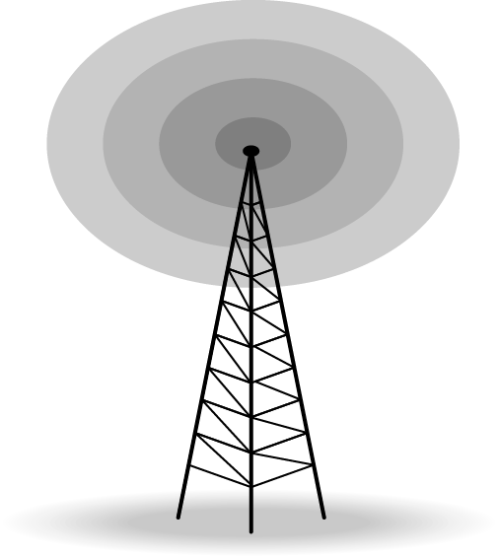
Radio Waves
Omnidirectional free-space radiation.
Frequency range: kilohertz levels.
Antennas need not align.
Used for multicast services.

Slide 5
Radio: Uses/Advantages
Applications: FM, TV, paging.
Highly regulated spectrum usage.
Omni antennas commonly deployed.
Wide area, mobile support.
Higher rates achievable contextually.

Slide 6
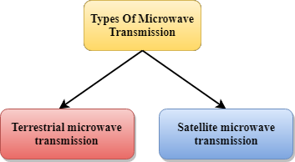
Microwaves (Overview)
Microwaves are of two types:
  Terrestrial microwave
  Satellite microwave communication

Slide 7
Terrestrial Microwave
Focused beams ground-to-ground.
Frequencies 1–1000 GHz stated.
Antennas aligned, narrow beams.
Towers spaced kilometers apart.
Requires clear line-of-sight.

Slide 8
Satellite Microwave Communication
Orbiting relays above Earth.
Flexible versus cable, fiber.
Global communication coverage possible.
Satellite amplifies, retransmits signals.
Links between earth stations.

Slide 9
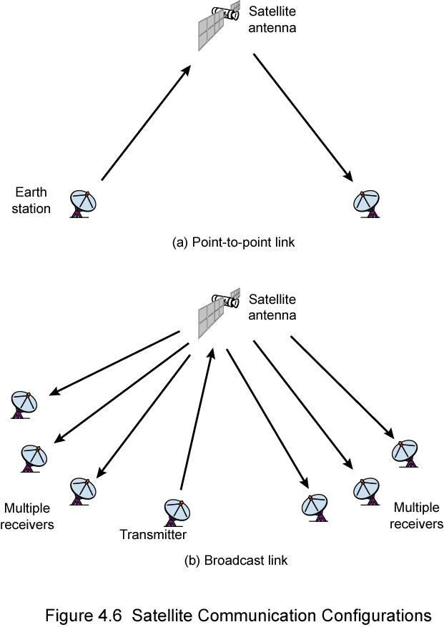

Slide 10
Infrared
Short-range wireless technology.
Frequencies: 300 GHz–400 THz.
Examples: remotes, nearby transfers.
Requires line-of-sight indoors.
Not reliable outdoors, sunlight.

Slide 11
THANK YOU

